Slide 1
Lecture 09: Iteration Statements

Slide 2
Objectives
Understand ‘for’ loop in ‘C’
Understand the ‘while’ loop and the ‘do-while’ loop
Work with break and continue statements
Understand the exit() function

Slide 3
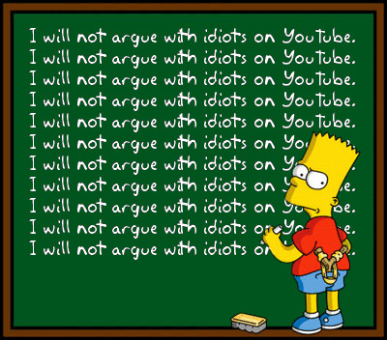
Introduction to Loops

Slide 4
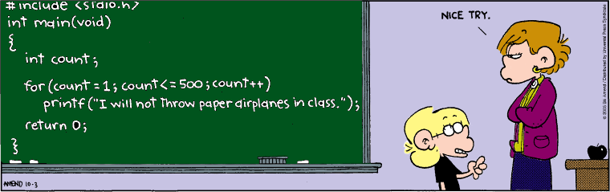
Introduction to Loops

Slide 5
What is a loop?
Section of code in a program
which is executed repeatedly,
until a specific condition is satisfied
There are three types of loop structures
“for” loop
“while” loop
“do…while” loop

Slide 6
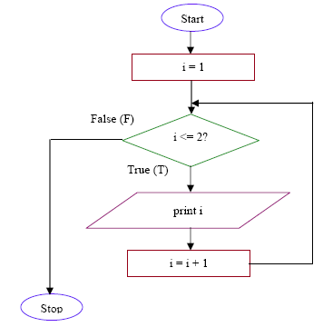
Loop Flowchart

Slide 7
General form of a for loop
General form
for (expression1; expression2; expression3 ){
// one or more statements;
}
Expression1
Initializes counter/index variable
Is usually an assignment statement
Is executed once at the beginning (only once)
Expression 2
Sets terminating condition
Is evaluated at the beginning of every iteration
If true statements inside the loop is executed; if false exit the loop
Expression 3
Is the loop variant/modifier (increment/decrement)
Is evaluated at the end of every iteration

Slide 8
For statement
for (initialization ; condition ; increment / decrement ){
// one or more statements;
}
?
true

Slide 9
For statement
for (initialization ; condition ; increment / decrement ){
// one or more statements;
}
?
true

Slide 10
For statement
for (initialization ; condition ; increment / decrement ){
// one or more statements;
}
?
true

Slide 11
For statement
for (initialization ; condition ; increment / decrement ){
// one or more statements;
}
?
false

Slide 12
For loop example - requirement
Make a program to display this message, using for loop
This is a
nice
nice
nice
nice
nice
nice
world!

Slide 13
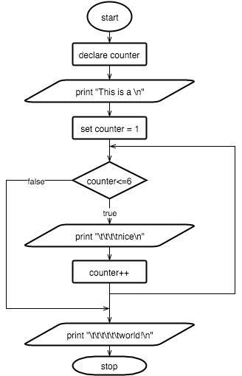
Flow chart

Slide 14
For loop example - code
void main()
{
int counter;
printf(”This is a\n");
for(counter = 1; counter <=6 ; counter++){
printf(“\t\tnice\n");
}
printf(“\t\t\t\tworld.\n");
}

Slide 15
Activity: for loop
Make a program to
Display integers from 1 to 10
Make another program to
Display odd integers in the range 1 to 10
Make another program to
Display even integers in the range 1 to 10

Slide 16
Activity: for loop (Homework)
Make a program to
Display integers from 10 to 1
Display odd integers in the range 10 to 1
Display even integers in the range 10 to 1
Nhap n < 10, in bang cuu chuong n

Slide 17
The “while” loop
Syntax
while (condition is true){
//one or more statements;
}
It’s entry controlled loop statement
The condition is true, the loop body is executed
Otherwise, the loop will finish

Slide 18
The “while” loop example
void main()
{
int c = 1;
while( c <= 10)
{
printf(“Iteration number %d\n”,c);
c++;
}
printf(“The loop is completed.\n”);
}

Slide 19
Activity: while loop
Using while loop, please:
Make a program to display odd integers in the range 1 to 10
Make another program to display even integers in the range 1 to 10

Slide 20
The “do-while” loop
Syntax
do {
//one or more statements;
} while (condition is true);
Program will always execute the loop body first
The body is always executed at least once
At the end of every loop, condition is evaluated
If it’s true, the loop continues
If it’s false, the loop finishes
The do-while statement must be terminated with ‘;’

Slide 21
The “do-while” loop example
void main()
{
int c = 1;
do
{
printf(“Iteration number %d\n”,c);
c++;
} while( c <= 10);
printf(“The loop is completed.\n”);
}

Slide 22
Activity: do-while loop
Using do-while loop, please:
Make a program to display odd integers in the range 1 to 10
Make another program to display even integers in the range 1 to 10

Slide 23
The break statement
The break statement can appear in the switch statement and the loop statement
It cause the execution of the current enclosing switch case or the loop to terminate
When it is encountered, all the rest of the codes after the break inside the code block are skipped
General syntax: break;

Slide 24
Activity – break example
void main ()
{
int i;
for(i = 1;i <=10; i++)
{
if(i==5){
break;
}
printf(”%d",i);
}
}

Slide 25
The continue statement
The break statement can only appear in the the loop statement
It’s used to terminate the current iteration only
It skips the rest of the statements in the body of the loop and begins next iteration
General syntax: continue;

Slide 26
Activity – continue example
void main ()
{
int i;
for(i = 1;i <=10; i++)
{
if(i==5){
continue;
}
printf(”%d",i);
}
}

Slide 27
The exit function
The exit function is used to terminate a program
It causes immediate termination of the program whenever executed
It may specifies the result of the termination (with error code or 0 for no error)
General syntax: exit(expression);

Slide 28
Activity: factorial – requirements (Homework)
Make a program to find factorial number
Specified as
If n = 0 or 1, n!=1
Otherwise, n!= 1*…*i; where i<=n

Slide 29
Activity: factorial - requirements
Input:
A positive integer
Process:
If n = 0 or 1, n!=1
Otherwise, n!= 1*…*n;
Output:
The factorial of the input integer

Slide 30
Flowchart
Find factorial number algorithm

Slide 31
Activity: factorial - code
Now write code for this activity (find factorial number)

Slide 32
Now you can do the menu
=======================
Add new student
View all students
Search students
Delete Students
Exit
=======================
Please choose:

Slide 33
Summaries
Understand ‘for’ loop in ‘C’
Understand the ‘while’ loop and the ‘do-while’ loop
Work with break and continue statements
Understand the exit() function

